Slide 1
Welcome To My Presentation
Presented By :- Karan More

Slide 2
Bank Management
Here is where my presentation begins

Slide 3
INTRODUCTION
A bank management system is a suite of software solutions that automate and manage various aspects of banking operations. This includes processing transactions, maintaining records, and complying with regulations.

Slide 4
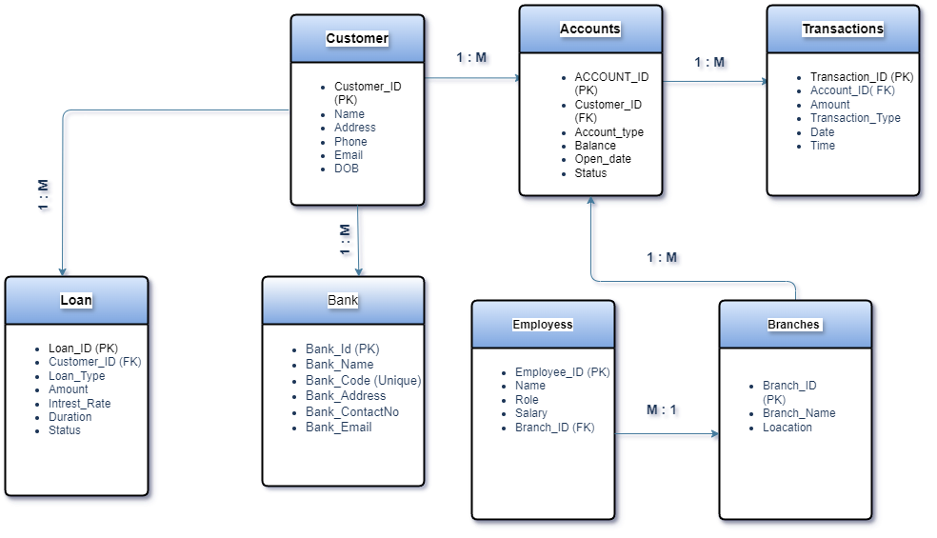
Entity Relationship Diagram

Slide 5
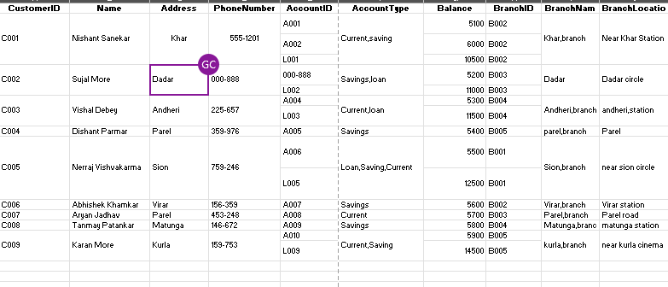
Raw table

Slide 6
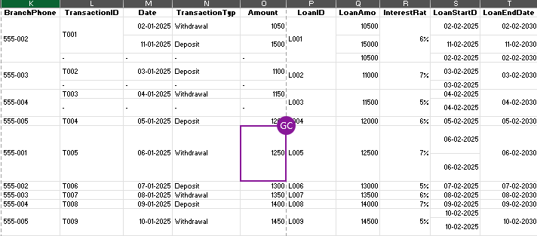
Raw table

Slide 7
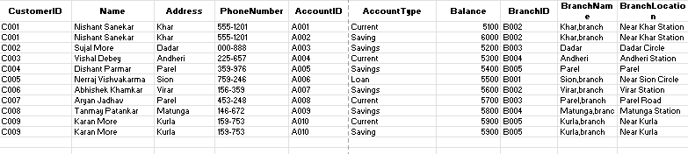
First Normal Form (1NF)

Slide 8
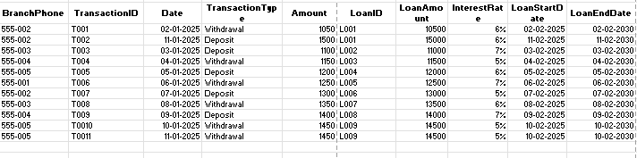
First Normal Form (1NF)

Slide 9
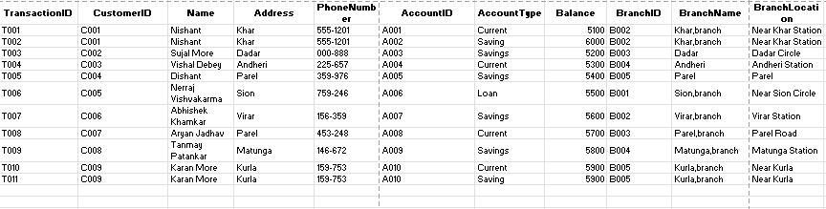
Second Normal Form (2NF)

Slide 10
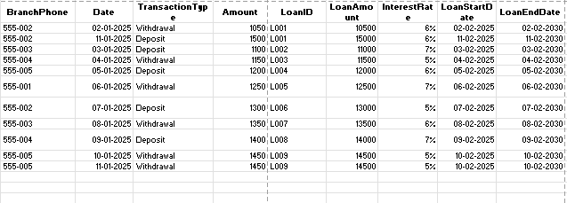
Second Normal Form (2NF)

Slide 11
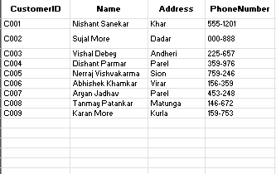
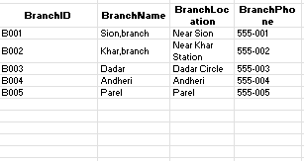
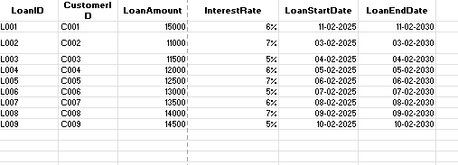
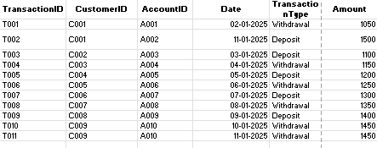
Third Normal Form (3NF)

Slide 12
TABLE OF CONTENTS
01
02
03
04
Bank Details
Branch
Account ID
Customers
05 Transaction ID
06 Loan ID

Slide 13
01
Table Description

Slide 14
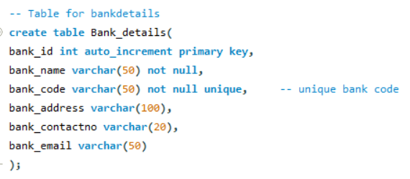
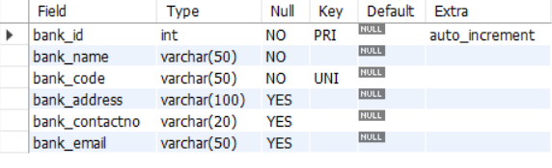
Bank Table

Slide 15
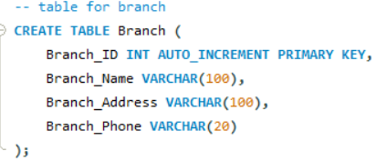
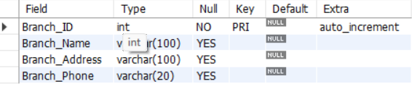
Branch Table

Slide 16
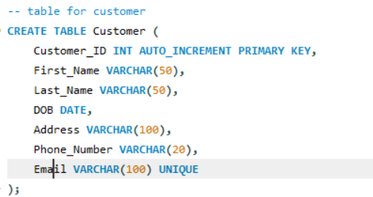
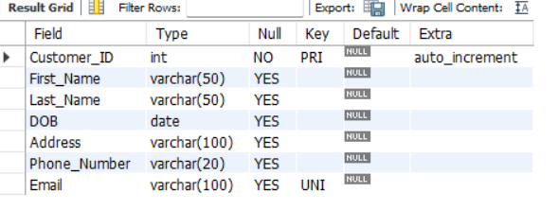
Customer Table

Slide 17
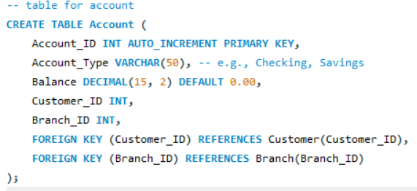
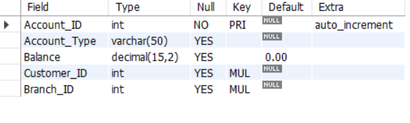
Account Table

Slide 18
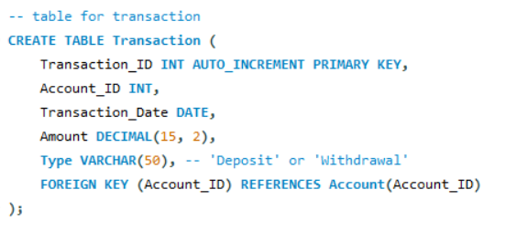
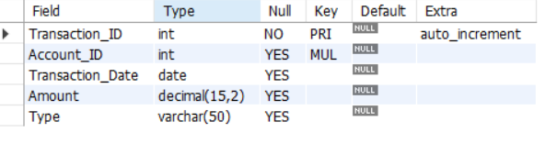
Transaction Table

Slide 19
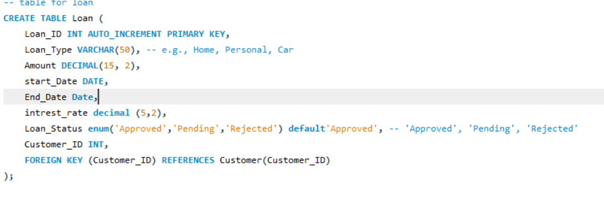
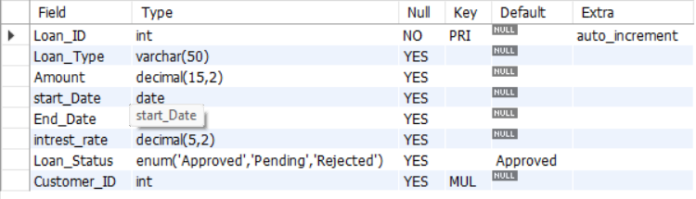
Loan Table

Slide 20
02
Inserting Table

Slide 21
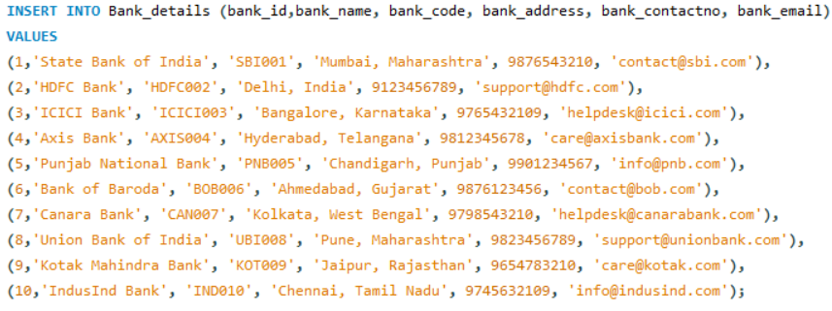
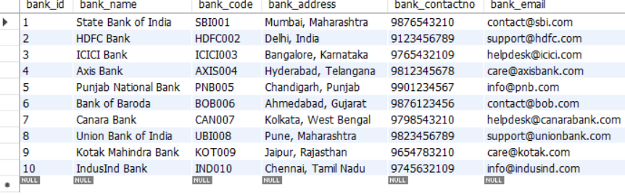
Inserting In Bank

Slide 22
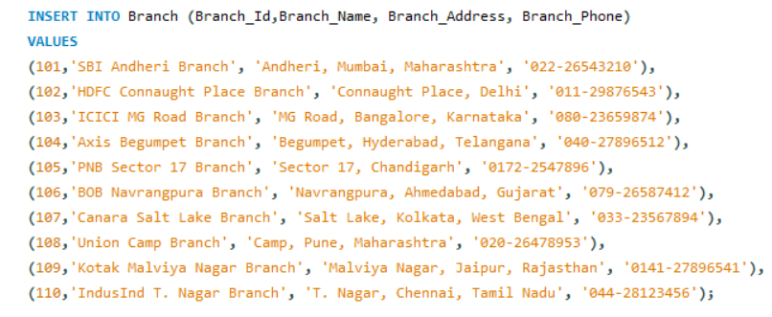
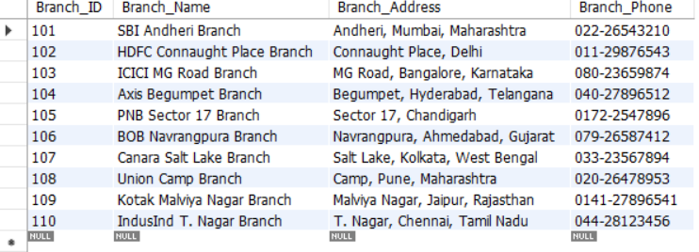
Inserting In Branch

Slide 23
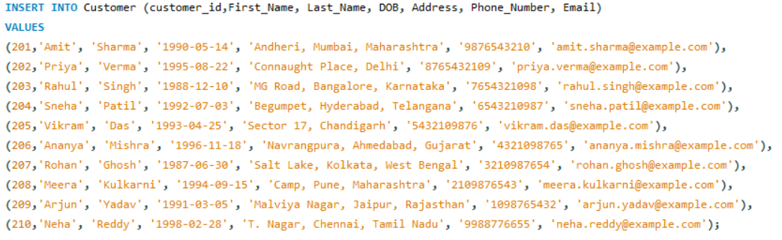
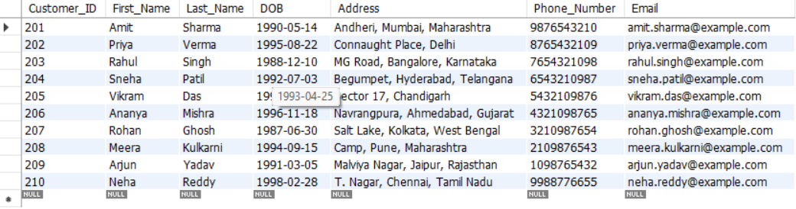
Inserting In Customer

Slide 24
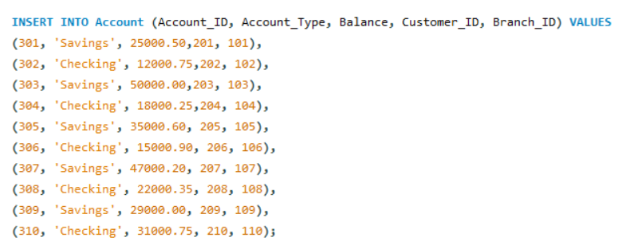
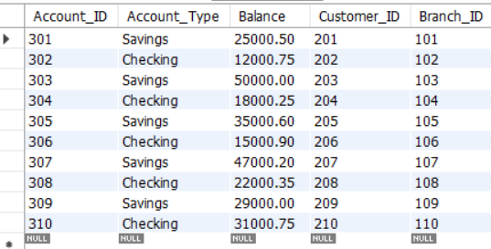
Inserting In Account

Slide 25
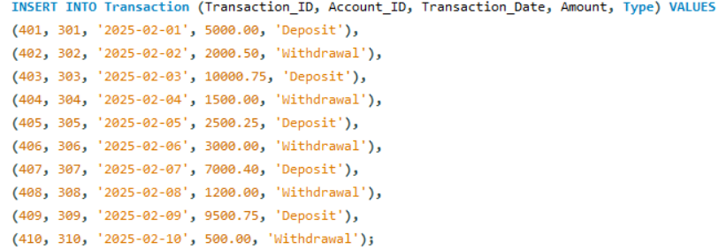
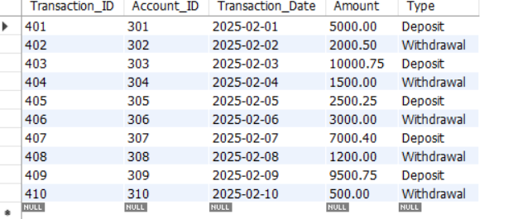
Inserting In Transaction

Slide 26
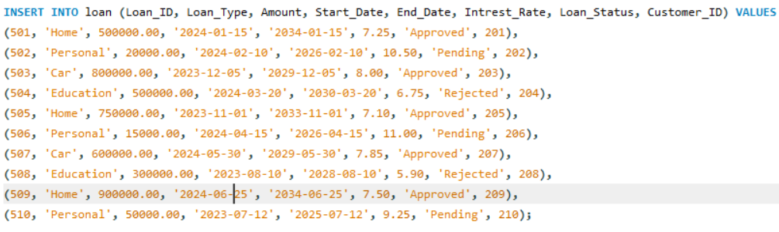
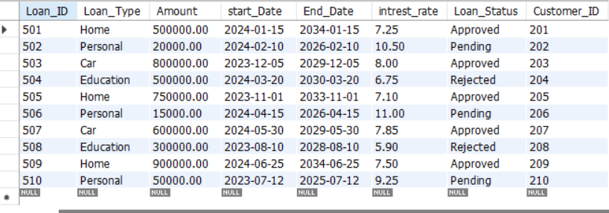
Inserting in Loan

Slide 27
Performing DML Operation
Insert
Update
Delete

Slide 28
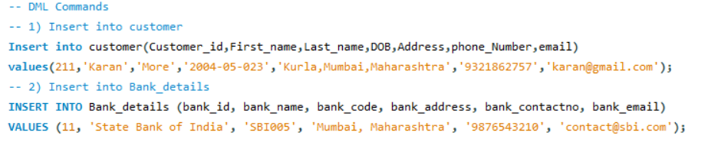
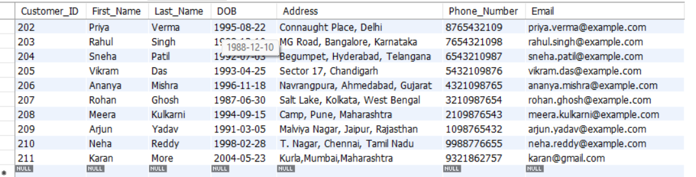
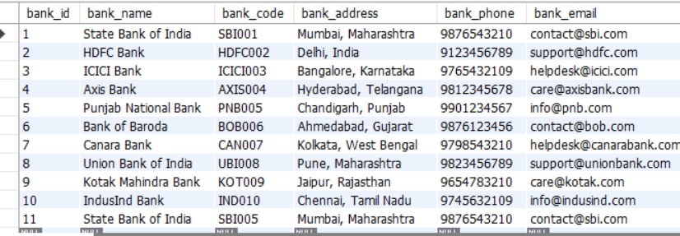
Insert Operation In MySQL, the INSERT statement is used to add new rows of data to a table.

Slide 29
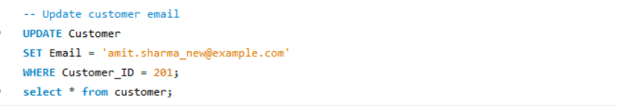
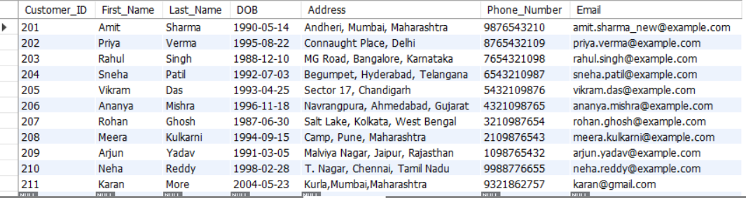
Update Operations The UPDATE statement in MySQL is used to modify existing records in a table.

Slide 30
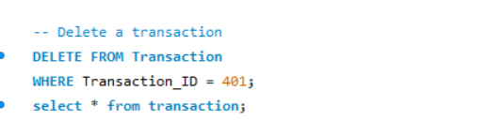
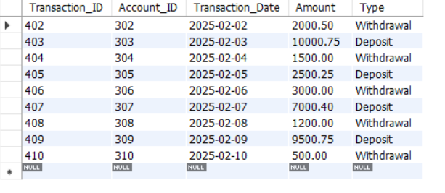
Delete Operation In MySQL, DELETE is a statement used to remove rows from a table based on a specified condition.

Slide 31
Performing DDL Operation
Create
Alter
Rename
Truncate
Drop

Slide 32
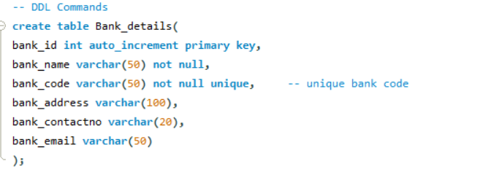
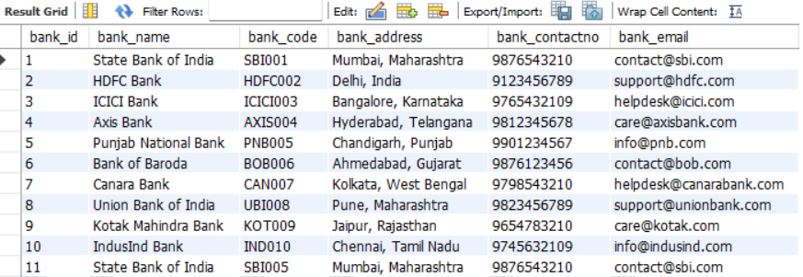
Create Operation In MySQL, the CREATE statement is used to create a new database, table, index, or other objects.

Slide 33
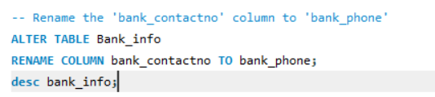
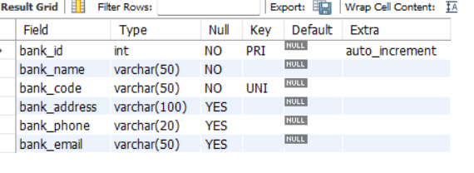
Alter Operation In MySQL, the ALTER statement is used to modify an existing database table.

Slide 34
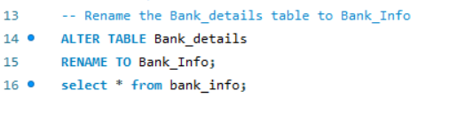
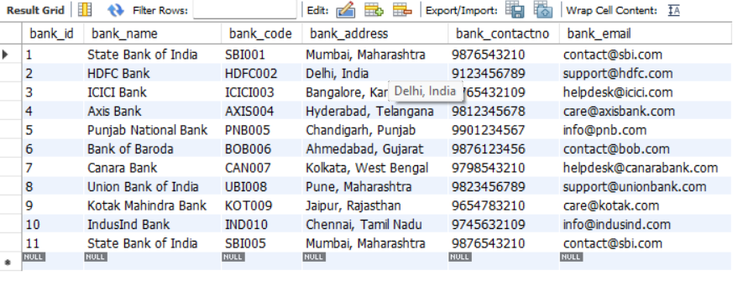
Rename Operation In MySQL, the RENAME command in SQL is used to change the name of a table or a column.

Slide 35
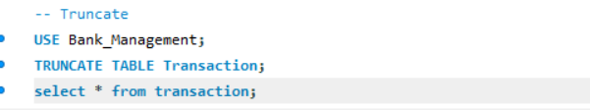

Truncate Operation In MySQL, TRUNCATE is a Data Definition Language (DDL) command used to quickly delete all rows from a table, resetting the auto-increment counter, if any

Slide 36
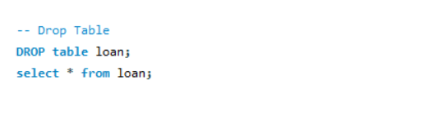

Drop Operation In MySQL, DROP is a SQL command used to delete a database, table, index, or other objects permanently.

Slide 37
Performing DQL Operation
Select
Order By
Distinct
Limit

Slide 38


Select Operation In MySQL, the SELECT statement is used to retrieve data from one or more tables

Slide 39


Order by Operation The ORDER BY clause in SQL is used to sort the result set of a query in either ascending (ASC) or descending (DESC) order based on one or more columns. By default, the sorting order is ascending if not explicitly mentioned.

Slide 40


Distinct Operation The ORDER BY clause in SQL is used to sort the result set of a query in either ascending (ASC) or descending (DESC) order based on one or more columns. By default, the sorting order is ascending if not explicitly mentioned.

Slide 41

Limit Operation In MySQL, LIMIT sets the limit that much return in the query

Slide 42
Performing Operatores Operation
Arithmetic Operators
Logical Operetor
Comparision Operetor
Pattern Matching Operetore

Slide 43


Arithmetic Operators
1. Aaddition (+)Adds two values together.
2. Subtraction(-) Subtracts the second value from the first.

Slide 44


Arithmetic Operators
3. Multiply(*) Multiplies two values.
4. Division (/) Divides the first value by the second.

Slide 45


Comparision Operators
5. = (Equal to)
6. != or <> (Not equal to)

Slide 46


Comparision Operators
7. > (Greater than)
8. < (Less than)

Slide 47


Comparision Operators
9. >= (Greater than or equal to)
10. <= (Greater than or equal to)

Slide 48


Logical Operators
1. AND (Both conditions must be true)
2. OR (At least one condition must be true)

Slide 49

Logical Operators
3. NOT (Negates a condition)

Slide 50

Patten Matching Operators
1. LIKE (Pattern matching)

Slide 51

Patten Matching Operators
2. In (with Not)

Slide 52

Patten Matching Operators
3. BETWEEN (Selects values in a range)

Slide 53


Pattern Matching Operators
4. IS NULL (Checks for NULL values)
5. IS NOT NULL (Checks for NOT NULL values)

Slide 54
Performing Build in Function
String Function
Aggregate Function
Math Function
Group by Having Function

Slide 55


String Function
1. Upper() Convert to Uppercase
2. Lower() Convert to Lowercase

Slide 56


String Function
3. Length() Find Length of a String
4. Concat() Concatenate Two Strings

Slide 57

String Function
5. Substring() Extract Partof a String

Slide 58


Aggregate Function
1. Count() Count Number of Records
2. Sum() Calculate Total balance

Slide 59


Aggregate Function
3. Avg() Find Average Balance
4. Max() Find Maximum Balance

Slide 60

Aggregate Function
5. Min() Find Minimum Balance

Slide 61


Math Function
1. ABS() – Absolute Value
2. CEIL() – Round Up to the Nearest Integer

Slide 62


Math Function
3. FLOOR() – Round Down to the Nearest Integer
4. ROUND() – Round to a Specific Decimal Place

Slide 63


Math Function
5. POWER() – Exponential Calculation
6. SQRT() – Square Root Calculation

Slide 64

GROUP BY and HAVING
AccountType groups where the total balance is greater than 28000

Slide 65
Subquery

Slide 66
A subquery is a nested query within another SQL query. Subqueries can be used in various clauses like SELECT, FROM, WHERE, etc., to perform advanced data retrieval and filtering

Slide 67
JOIN

Slide 68

SQL joins are used to combine rows from two or more tables based on a related column.

Slide 69


Inner Join

Slide 70


Right Join

Slide 71


Left Join

Slide 72
VIEW

Slide 73

A view in SQL is a virtual table that provides a way to store a query for future use. It is not a physical table but rather a stored SQL query that can be treated like a table in SELECT statements.

Slide 74
Store Procedure & Store Function

Slide 75


A Stored Procedure is a precompiled collection of SQL statements and optional control-flow logic stored in a relational database.

Slide 76


A Stored Function in MySQL is a reusable SQL code block that performs a specific task and returns a single value.

Slide 77
Trigger

Slide 78


A Trigger in MySQL is a database object that is automatically executed or fired when a specified event occurs on a table.

Slide 79
Cursor

Slide 80


In MySQL, a cursor is a database object that allows row-by-row processing of a result set.

Slide 81
THANKS!

